Slide 1
PPT PRESENTATION ON IMAGE CAPTIONING
PRESENTED BY

Slide 2
Contents
Introduction
Design of Queuing Model
Results and Discussion
Conclusions

Slide 3
Introduction
Image Captioning is the task of describing the content of an image in words. This task lies at the intersection of computer vision and natural language processing. Most image captioning systems use an encoder-decoder framework, where an input image is encoded into an intermediate representation of the information in the image, and then decoded into a descriptive text sequence. The most popular benchmarks are no caps and COCO, and models are typically evaluated according to a BLEU or CIDER metric.

Slide 4
Design Of Queuing Model
The following important performance parameters is calculated which are as follows: .
Inception v3:
A deep convolutional neural network (CNN) for image classification and feature extraction.
Uses techniques like factorized convolutions, auxiliary classifiers, and batch normalization to improve accuracy and efficiency.
Pre-trained models are available for transfer learning.
LSTM (Long Short-Term Memory):
A type of recurrent neural network (RNN) designed to handle sequential data.
Employs memory cells with forget, input, and output gates to learn long-term dependencies.
Ideal for tasks like time-series forecasting, language modeling, and sequence prediction.
Combining Inception v3 and LSTM:
Feature Extraction: Use Inception v3 to convert images or video frames into feature vectors.
Sequence Modeling: Feed these features into an LSTM to learn temporal relationships.
Applications: Video classification, image captioning, activity recognition.

Slide 5
Design Of Queuing Model
Training Workflow:
Preprocess Data: Resize, normalize, and label image sequences or videos.
Feature Extraction: Use pre-trained Inception v3 to generate embeddings.
Design LSTM Network: Stack LSTM layers and add dropout for regularization.
Compile Model: Choose a loss function (e.g., cross-entropy) and optimizer (e.g., Adam).
Train: Use mini-batches, monitor validation metrics, and save checkpoints.
Evaluate: Test on unseen data for accuracy and generalization.

Slide 6
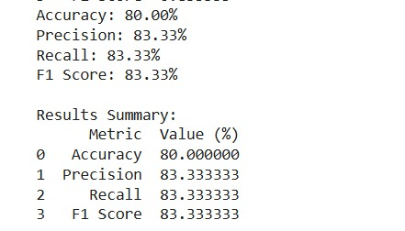
Results and Discussion

Slide 7
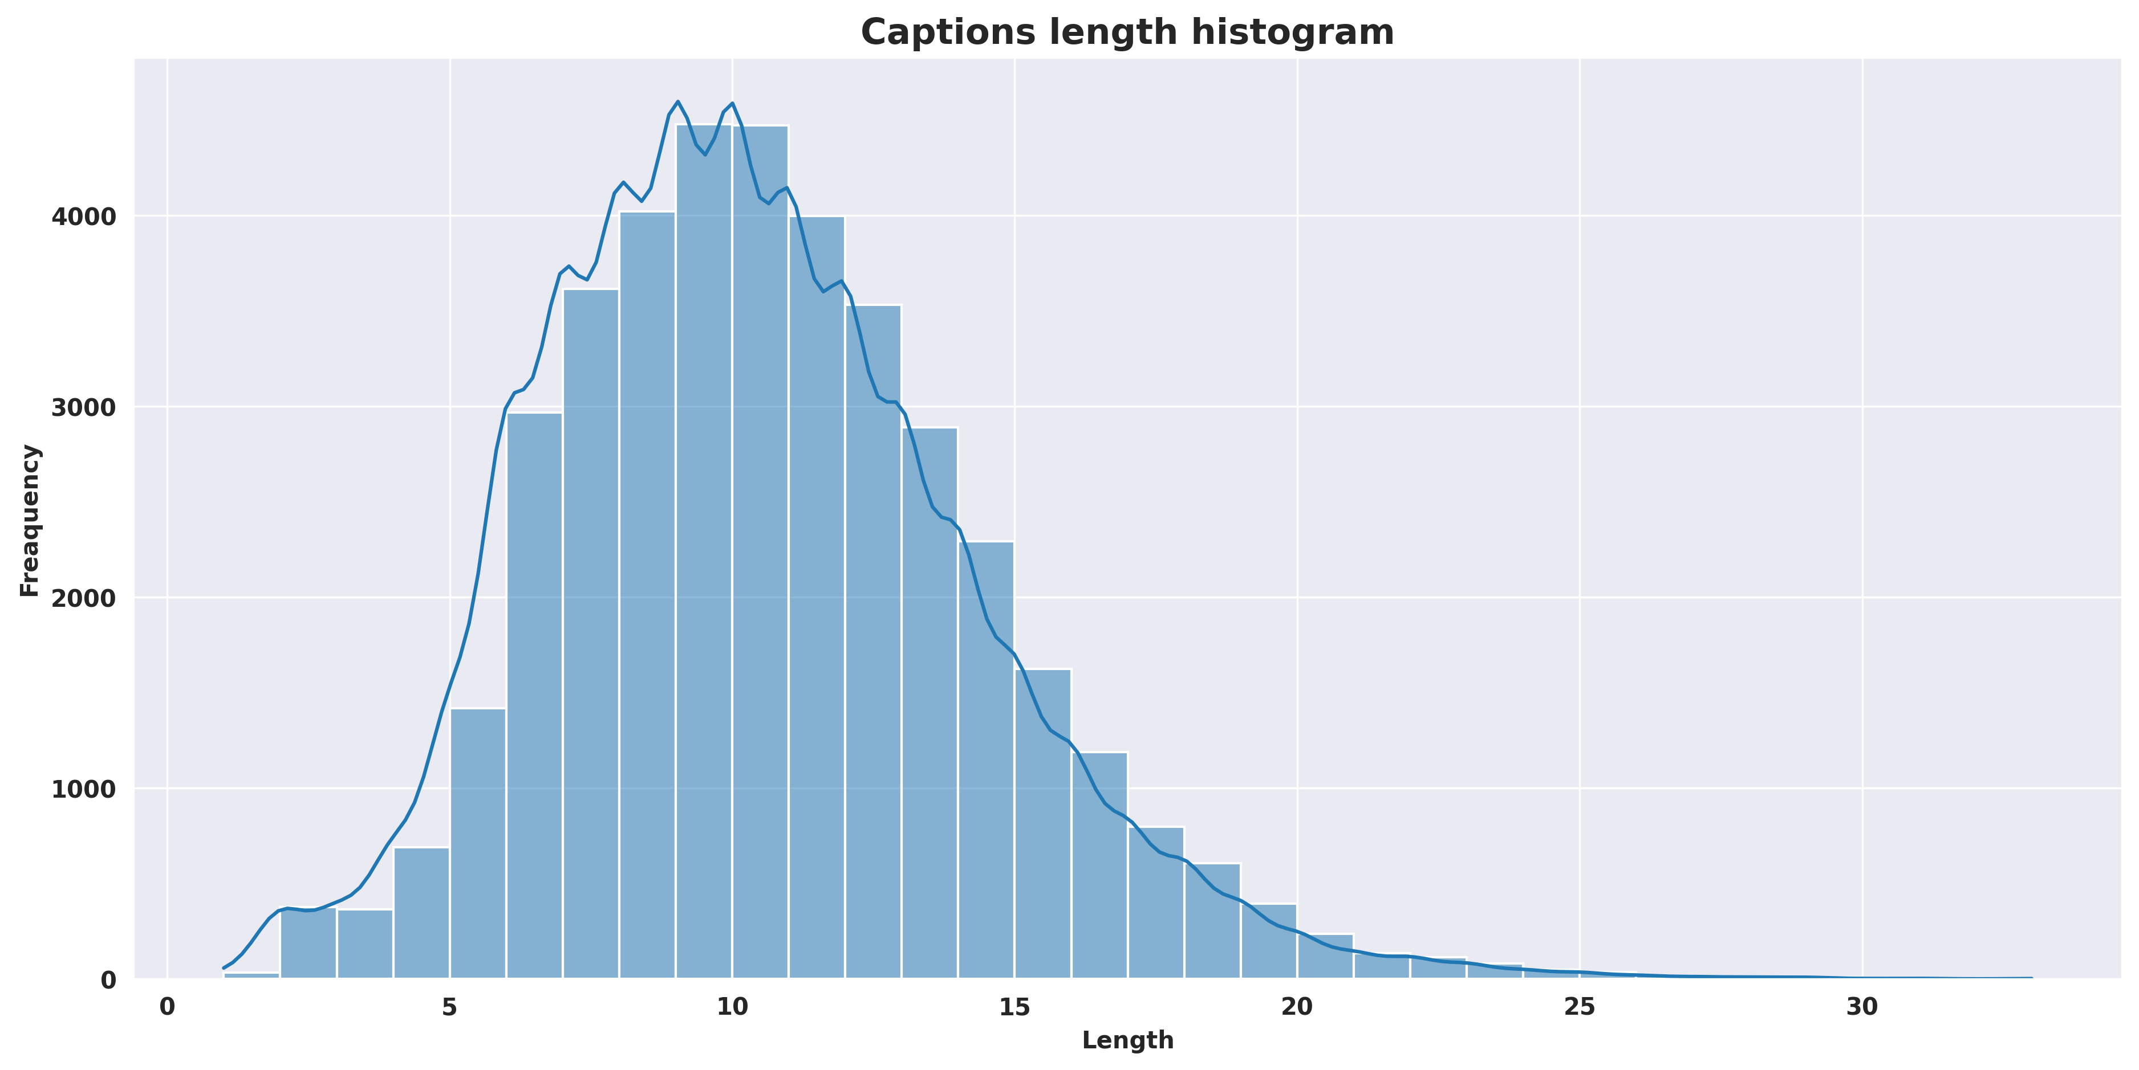
Results and Discussion

Slide 8
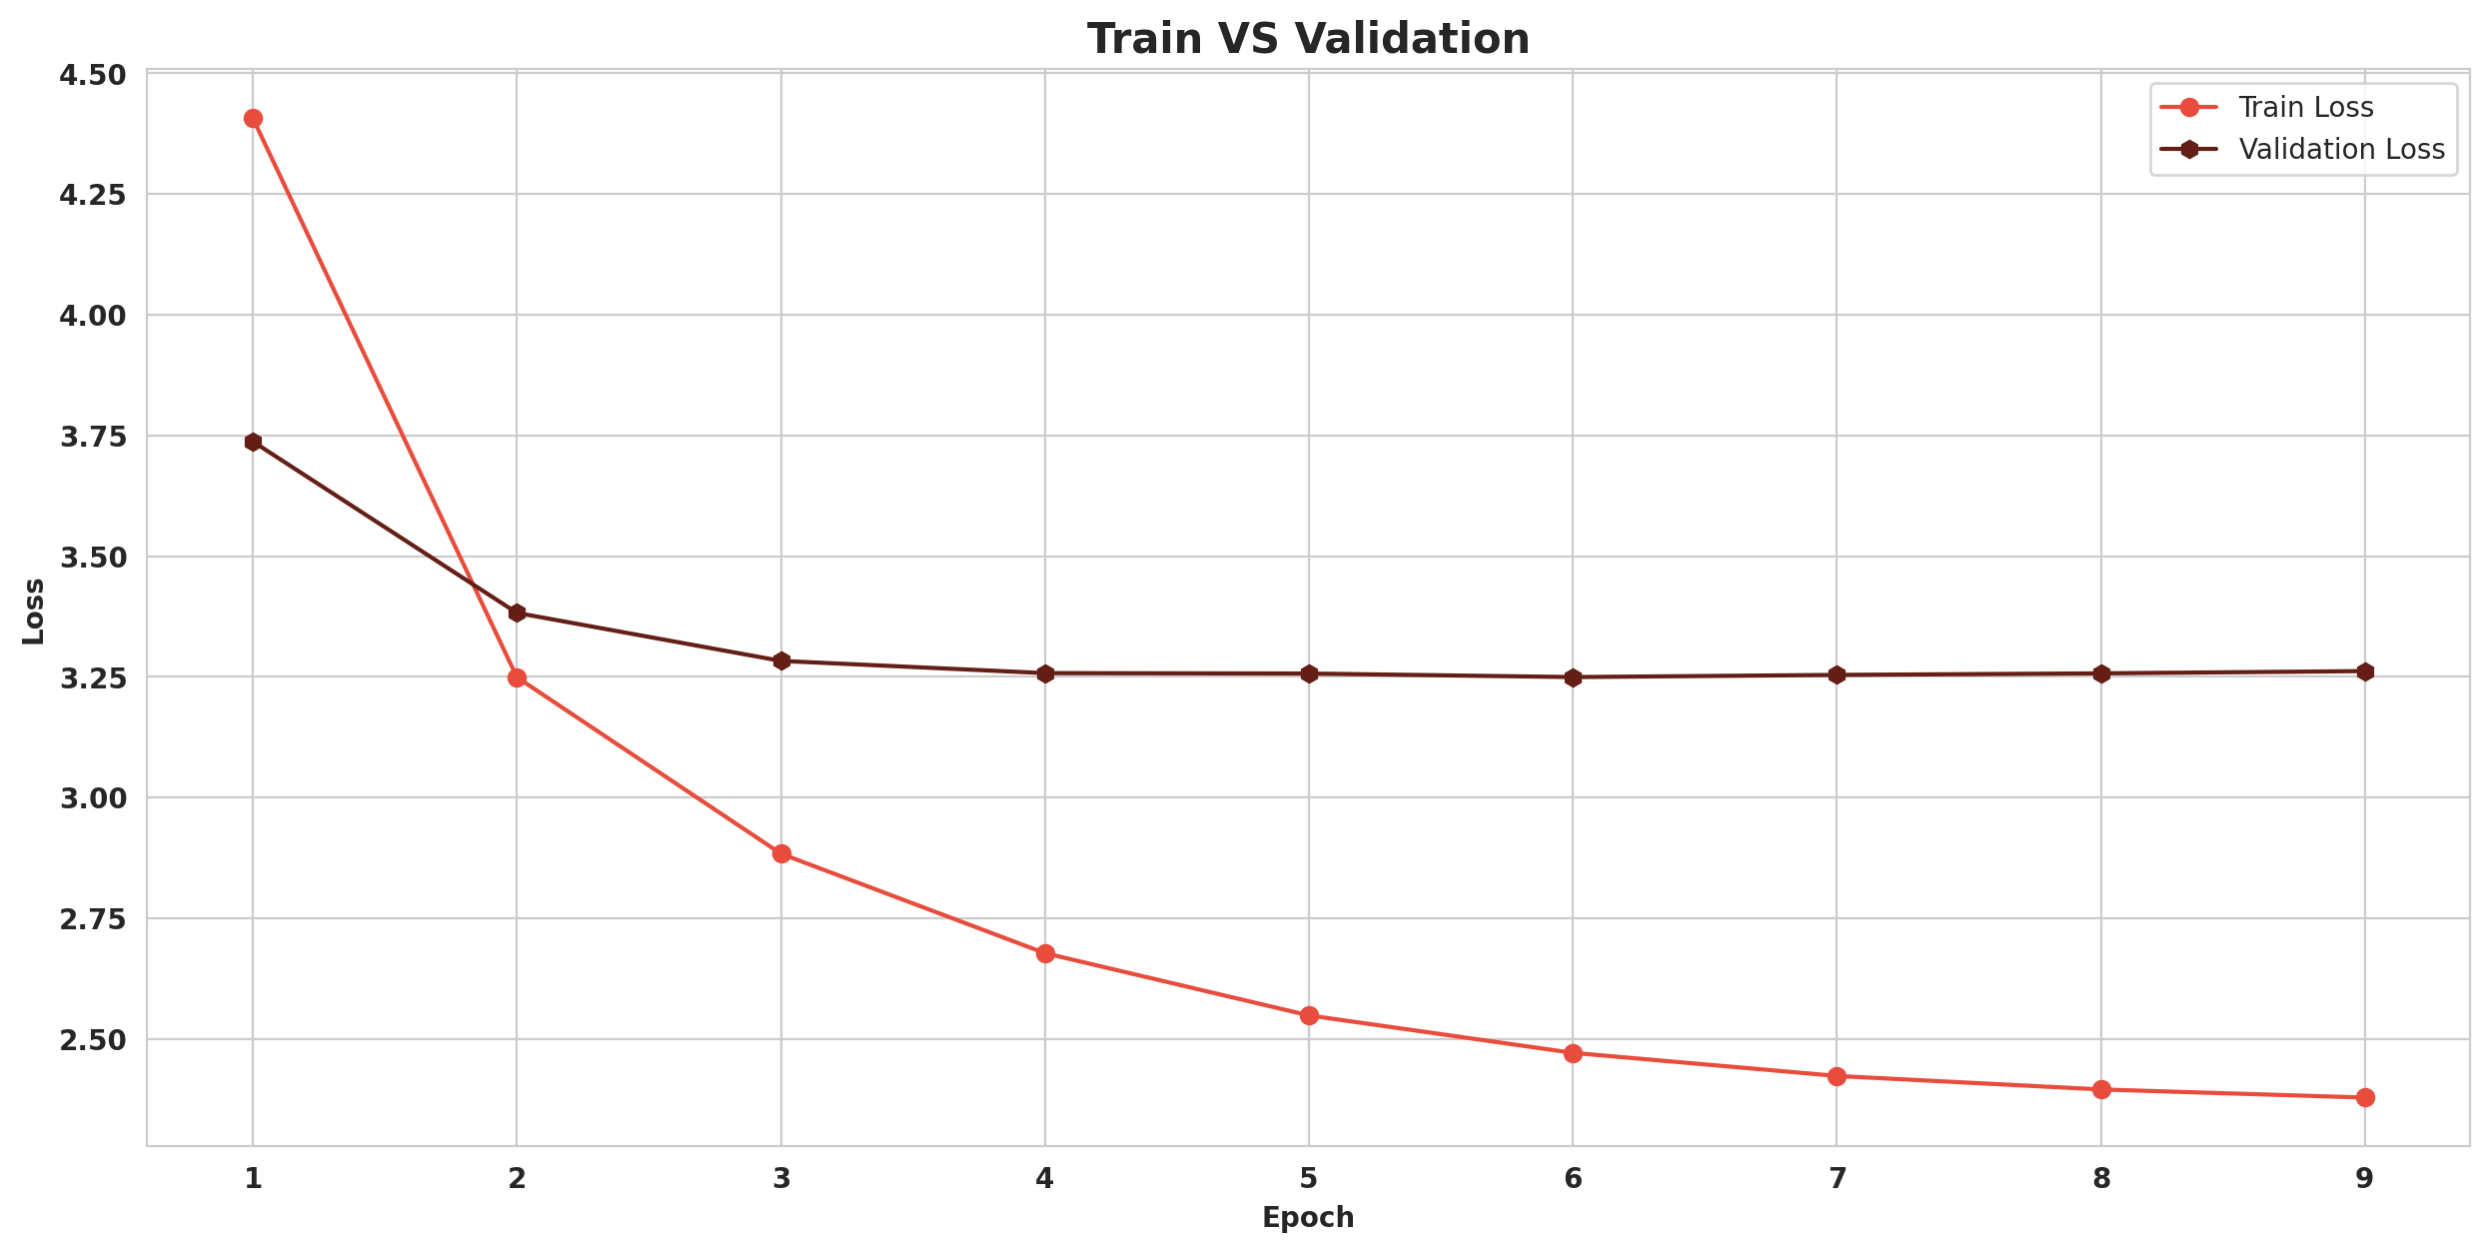
Results and Discussion

Slide 9
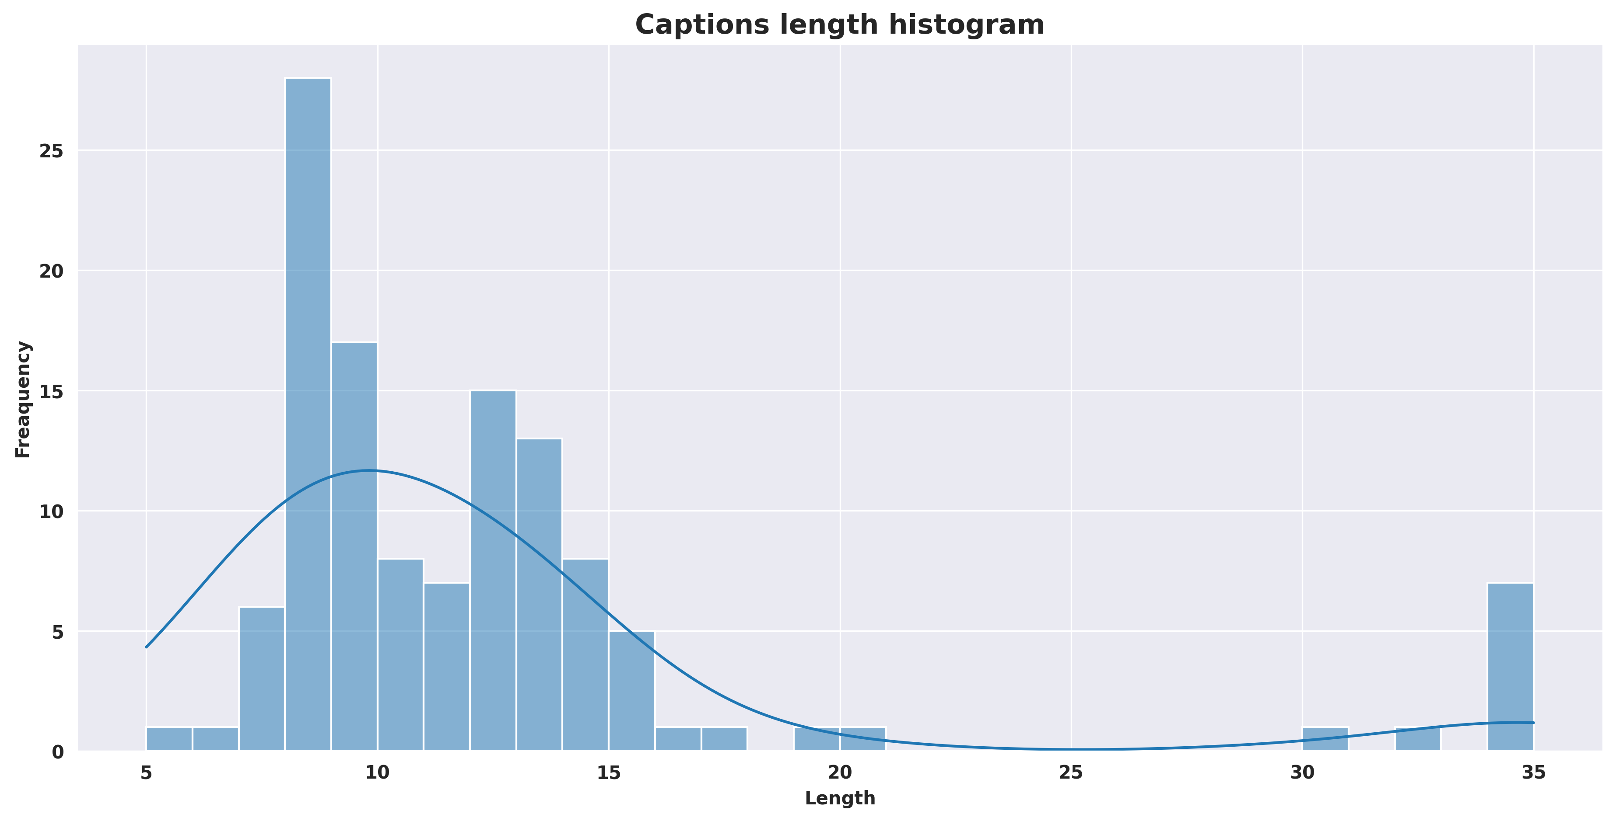
Results and Discussion

Slide 10
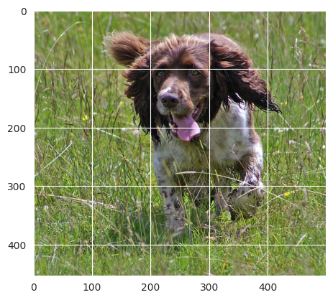
Results and Discussion

Slide 11
Conclusions
The advancements in image captioning powered by generative AI have significantly transformed the way we understand and interact with visual content. By enabling machines to describe images in human-like language, we bridge the gap between visual and textual information, enhancing accessibility and opening new avenues for innovation. As these technologies continue to evolve, we can look forward to even more sophisticated and accurate systems that not only complement human capabilities but also create new possibilities across various fields such as education, healthcare, and creative industries. The future of generative AI in image captioning is indeed bright and full of potential.

Slide 12


